Slide 1
ARM MEMORY INTERFACING
SHRIRAM K VASUDEVAN

Slide 2
MEMORY HIERARCHY
A modern microprocessor can execute instructions at a very high rate.
To exploit this potential performance fully the processor must be connected to a memory system which is both very large and very fast.
If the memory is too small, it will not be able to hold enough programs to keep the processor busy.
If it is too slow, the memory will not be able to supply instructions as fast as the processor can execute them.
Unfortunately, the larger a memory is the slower it is. It is therefore not possible to design a single memory which is both large enough and fast enough to keep a high-performance processor busy.

Slide 3

CONTD.,
It is, however, possible to build a composite memory system which combines a small, fast memory and a large, slow main memory to present an external behaviour which, with typical program statistics, appears to behave like a large, fast memory much of the time.
The small, fast memory component is the cache, which automatically retains copies of instructions and data that the processor is using most frequently.
The effectiveness of the cache depends on the spatial locality and temporal locality properties of the program.

Slide 4
Contd.,
With suitable memory management support, the size of a program is limited not by the computer's main memory but by the size of the hard disk, which may be very much larger than the main memory.

Slide 5
Memory size and speed
A typical computer memory hierarchy comprises several levels, each level having a characteristic size and speed:
The processor registers can be viewed as the top of the memory hierarchy. A RISC processor will typically have around thirty-two 32-bit registers making a total of 128 bytes, with an access time of a few nanoseconds.
On-chip cache memory will have a capacity of eight to 32 Kbytes with an access time around ten nanoseconds.
High-performance desktop systems may have a second-level off-chip cache with a capacity of a few hundred Kbytes and an access time of a few tens of nanoseconds.
Main memory will be megabytes to tens of megabytes of dynamic RAM with an access time around 100 nanoseconds.
Backup store, usually on a hard disk, will be hundreds of Mbytes up to a few Gbytes with an access time of a few tens of milliseconds.

Slide 6
Contd.,
Note that the performance difference between the main memory and the backup store is very much greater than the difference between any other adjacent levels, even when there is no secondary cache in the system.
The data which is held in the registers is under the direct control of the compiler or assembler programmer, but the contents of the remaining levels of the hierarchy are usually managed automatically.
Paging between the main memory and the backup store is controlled by the operating system, and remains transparent to the application program. Since the performance difference between the main memory and the backup store is so great, much more sophisticated algorithms are required here to determine when to migrate data between the levels.

Slide 7
Contd.,
An embedded system will not usually have a backing store and will therefore not exploit paging.
However, many embedded systems incorporate caches, and ARM CPU chips employ a range of cache organizations.
Fast memory is more expensive per bit than slow memory, so a memory hierarchy also aims to give a performance close to the fastest memory with an average cost per bit approaching that of the slowest memory.

Slide 8
On-chip memory
Some form of on-chip memory is essential if a microprocessor is to deliver its best performance.
With today's clock rates, only on-chip memory can support zero wait state access speeds, and it will also give better power-efficiency and reduced electromagnetic interference than off-chip memory.
In many embedded systems simple on-chip RAM is preferred to cache for a number of reasons:
It is simpler, cheaper, and uses less power.
It has more deterministic behaviour
Cache memories have complex behaviours which can make difficult to predict how well they will operate under particular circumstances. In particular, it can be hard to guarantee interrupt response time.

Slide 9
Contd.,
The drawback with on-chip RAM vis-d-vis cache is that it requires explicit management by the programmer, whereas a cache is usually transparent to the programmer.
One important advantage of on-chip RAM is that it enables the programmer to allocate space in it using knowledge of the future processing load.
A cache left to its own devices has knowledge only of past program behaviour, and it can therefore never prepare in advance for critical future tasks. Again, this is a difference which is most likely to be significant when critical tasks must meet strict real time constraints.

Slide 10
caches
A cache memory is a small, very fast memory that retains copies of recently used memory values.
It operates transparently to the programmer, automatically deciding which values to keep and which to overwrite.
These days it is usually implemented on the same chip as the processor.
Caches work because programs normally display the property of locality, which means that at any particular time they tend to execute the same instructions many times (for instance in a loop) on the same areas of data (for instance a stack).

Slide 11
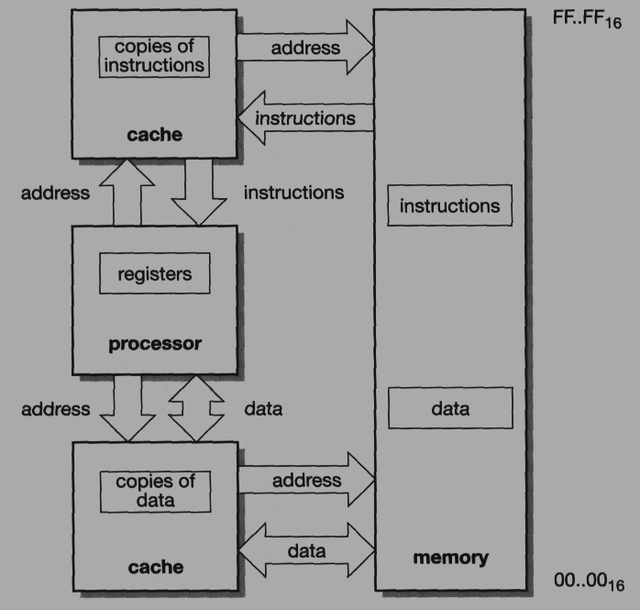
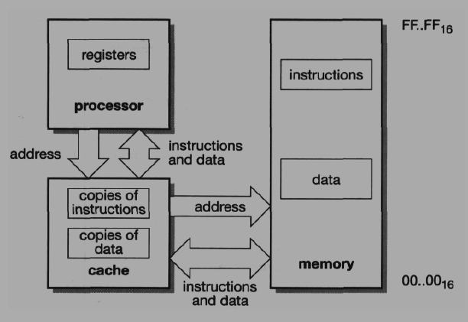
Unified and Harvard caches
Caches can be built in many ways. At the highest level a processor can have one of the following two organizations:
A unified cache.
This is a single cache for both instructions and data.
Separate instruction and data caches.
This organization is sometimes called a modified Harvard architecture.

Slide 12
So ???
Both these organizations have their merits. The unified cache automatically adjusts the proportion of the cache memory used by instructions according to the current program requirements, giving a better performance than a fixed partitioning.
On the other hand the separate caches allow load and store instructions to execute in a single clock cycle.

Slide 13
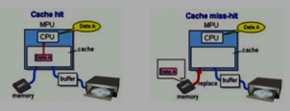
Cache performance metrics
Since the processor can operate at its high clock rate only when the memory items it requires are held in the cache, the overall system performance depends strongly on the proportion of memory accesses which cannot be satisfied by the cache.
An access to an item which is in the cache is called a hit, and an access to an item which is not in the cache is a miss.
The proportion of all the memory accesses that are satisfied by the cache is the hit rate, usually expressed as a percentage, and the proportion that are not is the miss rate.

Slide 14
Contd.,
The miss rate of a well-designed cache should be only a few per cent if a modern processor is to fulfil its potential.
The miss rate depends on a number of cache parameters, including its size (the number of bytes of memory in the cache) and its organization.
Note this!!
Since a cache holds a dynamically varying selection of items from main memory, it must have storage for both the data and the address at which the data is stored in main memory.

Slide 15
Cache organization direct mapped cache
The simplest organization of these components is the direct-mapped cache.
In the direct-mapped cache a line of data is stored along with an address tag in a memory which is addressed by some portion of the memory address (the index)
To check whether or not a particular memory item is stored in the cache, the index address bits are used to access the cache entry.
The top address bits are then compared with the stored tag; if they are equal, the item is in the cache. The lowest address bits can be used to access the desired item within the line.

Slide 16
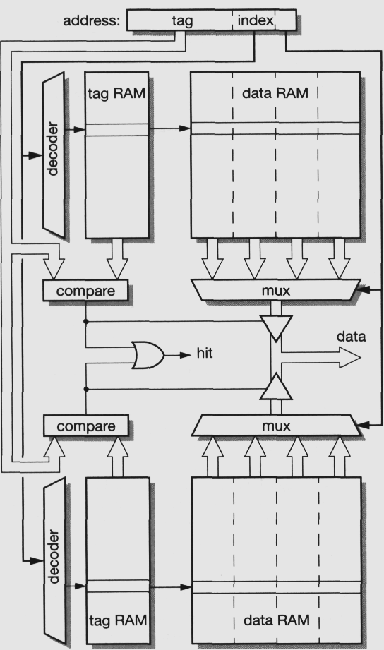
Set associative cache
this form of cache is effectively two direct-mapped caches operating in parallel.
An address presented to the cache may find its data in either half, so each memory address may be stored in either of two places.
When a new data item is to be placed in the cache, a decision must be taken as to which half to place it in. There are several options here, the most common being:
Random allocation.
Least recently used (LRU).
The cache keeps a record of which location of a pair was last accessed and allocates the new data to the other one.
Round-robin (also known as 'cyclic').
The cache keeps a record of which location of a pair was last allocated and allocates the new data to the other one.

Slide 17
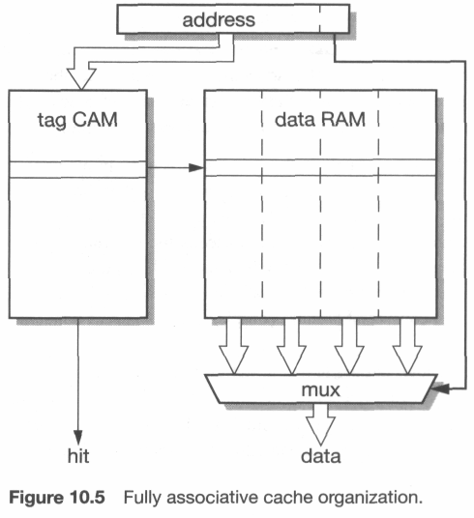
Fully associate cache
At the other extreme of associativity, it is possible to design a fully associative cache in VLSI technology.
Rather than continuing to divide the direct-mapped cache into cache ever smaller components, the tag store is designed differently using content addressed memory (CAM).
A CAM cell is a RAM cell with an inbuilt comparator, so a CAM based tag store can perform a parallel search to locate an address in any location.

Slide 18
Write strategies
The above schemes operate in an obvious way for read accesses:
when presented with a new read address the cache checks to see whether it holds the addressed data;
if it does, it supplies the data; if it does not, it fetches a block of data from main memory, stores it in the cache in some suitable location and supplies the requested data to the processor.

Slide 19
Contd.,
There are more choices to make when the processor executes a write cycle. In increasing order of complexity, the commonly used write strategies are:
Write-through:
All write operations are passed to main memory; if the addressed location is currently held in the cache, the cache is updated to hold the new value. The processor must slow down to main memory speed while the write takes place.
Write-through with buffered write:
Here all write operations are still passed to main memory and the cache updated as appropriate, but instead of slowing the processor down to main memory speed the write address and data are stored in a write buffer which can accept the write information at high speed. The write buffer then transfers the data to main memory, at main memory speed, while the processor continues with its next task.
Copy-back (also known as write-back)
A copy-back cache is not kept coherent with main memory. Write operations update only the cache, so cache lines must remember when they have been modified (usually using a dirty bit on each line or block). If a dirty cache line is allocated to new data it must be copied back to memory before the line is reused.

